Slide 1
International Vaccine Codes
December 2023

Slide 2
Agenda
Welcome & Introductions
Roundtable updates
CVX Updates Management
Next steps

Slide 3
Welcome
Purpose of call
Hear updates
Collect and analyze
Code set metrics
Central wiki page
Mappings?
In Scope
Vaccine code sets
National and universal
Technical/detail level
Out of Scope
Policy discussion
Which code sets to use
Software operation

Slide 4
Introductions
Name
Organization
What is the biggest challenge you are facing with vaccine code sets?

Slide 5
Roundtable Updates

Slide 6
Roundtable Updates
AIRA
Manufacturer code discussions

Slide 7
CVX Update Management

Slide 8
CVX Update Management
AIRA Update Process
NIST Update Process
Others

Slide 9
AIRA Process
Aggregate Analysis Reporting Tool
Immunization Information System (IIS) Sandbox
CDC Website
XML Artefacts
XML, Flat File
Compiled XML
Electronic Health Record (EHR) Sandbox
Curl
Java Logic
Email
Message Quality Evaluator (MQE)
Data at Rest (DAR)
Notes:
https://www.cdc.gov/vaccines/programs/iis/code-sets.html
https://github.com/immregistries/codebase

Slide 10
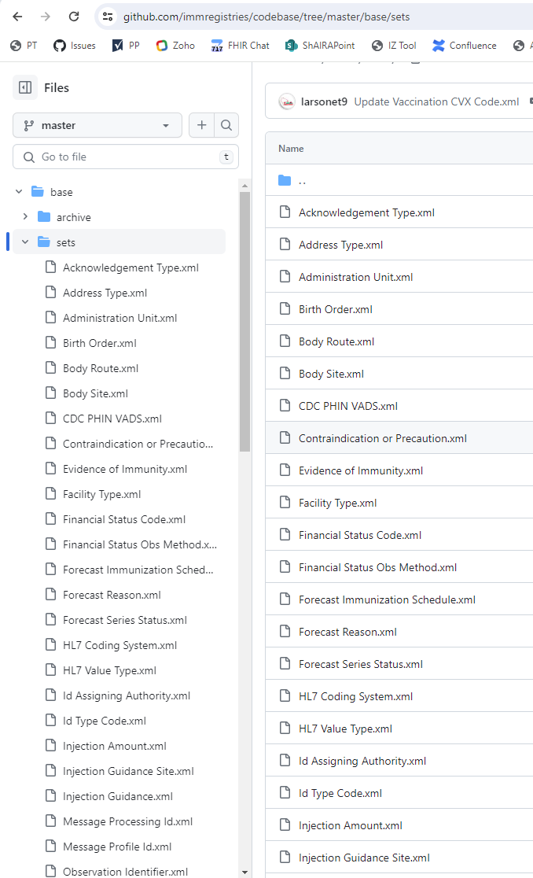
Overall Layout
XML for every table
Most are very stable
Some are updated
Some are faux
Examples:
Body Route
Vaccination CVX Code
Vaccination VIS CVX code
Injection Amount

Slide 11
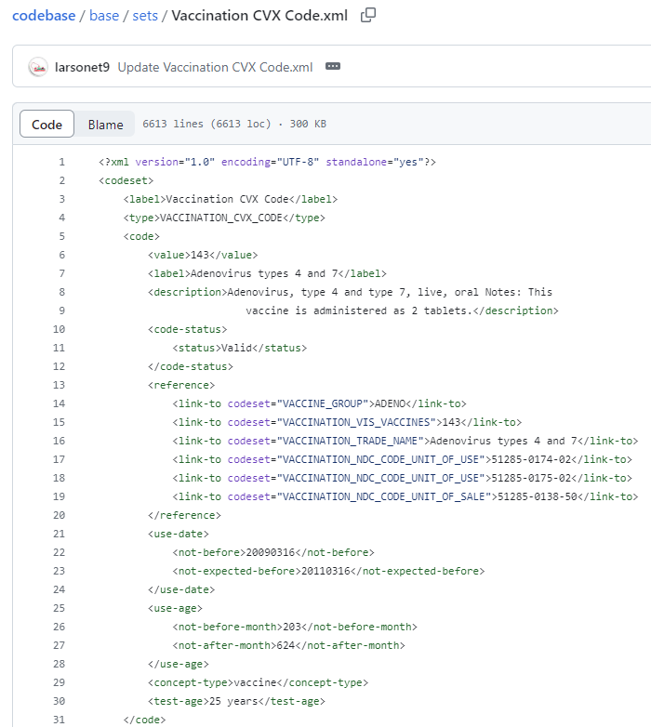
Structure
Originally created to support detecting data quality issues
Notes:
https://github.com/immregistries/codebase/blob/master/base/sets/Vaccination%20CVX%20Code.xml

Slide 13
Next Steps
Nathan Bunker, AIRA

Slide 14
Future Discussions
Topic suggestions for next time
SNOMED
Other ideas?

