Slide 1
International Vaccine Codes
July 2024

Slide 2
Agenda
Welcome & Introductions
Roundtable updates
Vision and Goals
Report back on Expert Interviews
Next steps
International Vaccine Codes (IVC) Initiative - 2024

Slide 3
Introductions
Name
Organization
Nathan Bunker (AIRA)
François Kaag (Syadem)
Dr Bryant Karras (WA DOH)
Sheryl Taylor (NIST)
Brittany Onye (WA DOH)
Chrissy Miner (CDC)
Clément Hennequin (NIST)
Roua El Kalach (CDC)
Paloma Hawry (CDC)
Faisal Reza (CDC)
International Vaccine Codes (IVC) Initiative - 2024

Slide 4
Roundtable Updates
International Vaccine Codes (IVC) Initiative - 2024

Slide 5
Roundtable Updates
United States
HTI-2 Regulation comment period
Certification extended to both EHR and IIS/EIR
International Patient Summary (IPS)
New guide getting ready for ballot
Smart Health Cards + Health Links
Mechanism for sharing is being balloted
Other countries or projects?
Implementation plans for Euvabeco plans, will be released in October
SNOMED international, conversations about how to align NUVA
Relationship between valences and substances
International Vaccine Codes (IVC) Initiative - 2024
Notes:
https://build.fhir.org/ig/HL7/fhir-ips/StructureDefinition-Immunization-uv-ips.html

Slide 6
Vision and Goals
Nathan Bunker (AIRA)
International Vaccine Codes (IVC) Initiative - 2024

Slide 7
Last Month
Vision
Scope
Primary Mission
Network of Experts
Advocate for code systems
Technical Support
International Vaccine Codes (IVC) Initiative - 2024

Slide 8
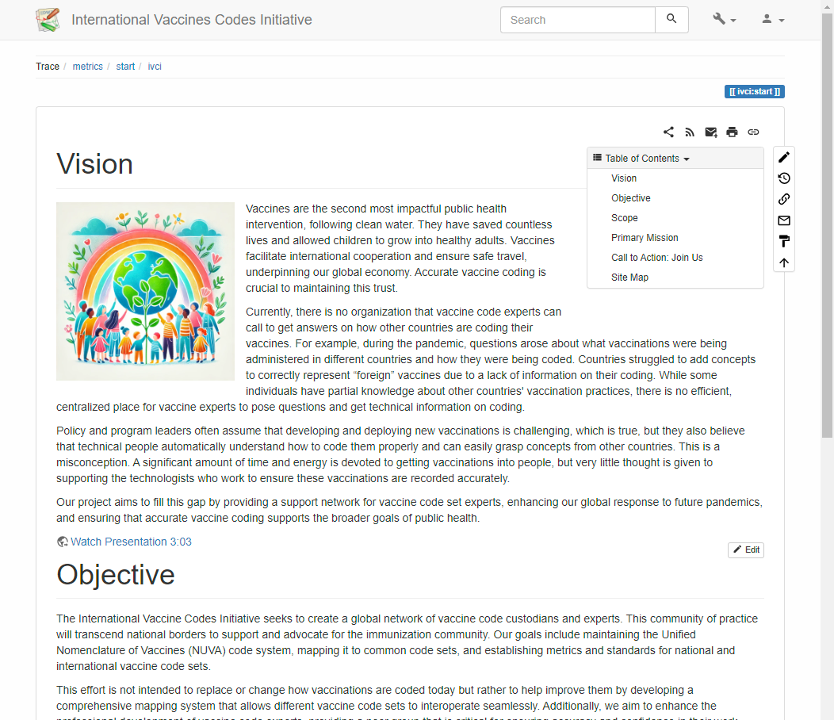
Website Updated
Vision
Objective
Scope
Primary Mission
Call to Action
International Vaccine Codes (IVC) Initiative - 2024

Slide 9
Vision
Vaccines save lives, secure global economy
Much thought is given to developing vaccines
Little support for those recording vaccinations
No community organizes work of vaccine code experts
No organization to call with questions
No systematic collection of information
We want to fill this gap
Enhance global response to future pandemics
Support broader goals of public health
International Vaccine Codes (IVC) Initiative - 2024

Slide 10
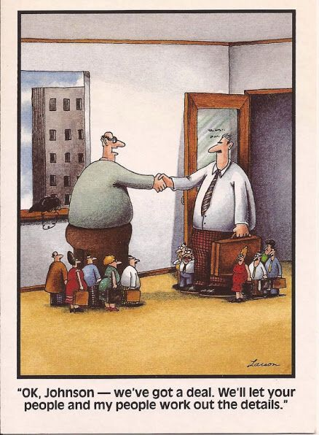
Primary Mission
Network of Experts
Provide peer support
Community of practice
Advocacy
For code system improvements
Accurate immunization histories
Technical Support
Maintain NUVA
Map code systems
Develop metrics and standards
International Vaccine Codes (IVC) Initiative - 2024

Slide 11
Primary Mission
Provide a place to convene
Vaccine code experts
Vaccine code information
Policy and program teams assume we know the answers
We need a community of practice
We need shared knowledge and tools
International Vaccine Codes (IVC) Initiative - 2024

Slide 12
Unified Nomenclature of Vaccines (NUVA)
Holds knowledge about vaccines
What they contain
What diseases they prevent
Will map common code sets to NUVA
Gaps will be filled by new concepts
Metrics describing code set
Code set can be improved
International Vaccine Codes (IVC) Initiative - 2024

Slide 13
In Scope
Most medications are relevant for less than 3 months
Aspirin given 3 years ago
MMR given 3 years ago
What do you need to know to ensure this patient is protected?
Given at any time
Anywhere in the world
We are dedicated to supporting this long-term and global view
International Vaccine Codes (IVC) Initiative - 2024

Slide 14
In Scope
Vaccine code set management
National and universal code sets
Technical and detailed level codes
Lifetime vaccination records
Emergency and clinical trial vaccinations
International Vaccine Codes (IVC) Initiative - 2024

Slide 15
Related, but Not In Scope
Medication supply
Inventory
Pharmacovigilance
Digital vaccine cards
International Vaccine Codes (IVC) Initiative - 2024

Slide 16
Out of Scope
Policy discussions
Code set selection
Software and systems
International Vaccine Codes (IVC) Initiative - 2024

Slide 17
Need Examples
Yellow Card example, has handwritten information
We want to provide the tooling, vocabulary so it’s much more valuable
International Certificate of Vaccination or Prophylaxis (ICVP), also known as the Carte Jaune or Yellow Card, is an official card report created by the (WHO)
IPS, there can be local codings
Original reason for NUVA: CDS
Need to be able to process information correctly to make a recommendation/assessing status

Slide 18
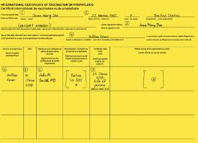
Conducting Expert Interviews
WHO Global Digital Health Certification Network (GDHCN)
Digitizing International Certificate of Vaccination or Prophylaxis (ICVP)
There are four competing digital vaccine card standards
Standing up service for countries to allow reporting of authorized vaccine products
Will continue tracking vaccine card efforts to understand how they use codes

Slide 19
Conducting Expert Interviews
US – Centers for Disease Control and Prevention
Need to collect information on vaccinations systematically
Common vocabulary about vaccine concepts
Hierarchy of concepts
Need structure and flexibility to adapt
Want to know what is being given worldwide
Lots of complexity
New technological platforms
Vaccine-adjacent medicines, such as monoclonal antibodies, cancer drugs
Vaccine trials (what about those?) Yet another complexity, at which point is it useful? Or is it too complicated? Maybe just retroactively? At some stage in the trial. Need common vocabulary and approaches that can be taken. It is a characteristic/status that we may need to have a structured way of recording that.
Trying to keep out of NUVA everything is that transient.
Does create forecast/assessment for someone
There were issues of how vaccines are approved, under different authorizations
Suggested: Authorization to give is out of scope
Need to record what the patient received, as long as there is clarity about what they received
Does impact how we assess immunity, different countries have different vaccines they accept, in scope be able to determine what is authorized, but what and when is authorized is out of scope
Transient, what is this referring to. Meaning legal authorization status.
Manufacturers have different partnerships
Needs to be a long-term project
Constant maintenance of concepts and codes
Operational activity as much as an aspirational activity

Slide 20
Next Steps
Reaching out to new countries and organizations
Who should I reach out to?
My current short list
Canada
France - perhaps
Netherlands
Switzerland
PAHO
PATH, BMGF
Global NITAG network
EHealth Network
ASTP / ONC
GDHP Global Digital Health Partnership (G20+ of Global Health)

Slide 21
Next Steps
Nathan Bunker, AIRA

Slide 22
Next Meeting
Next Meeting
September 11
Next In-Person
May 2025 – Bordeaux
Have a great summer!

