Slide 1
International Vaccine Codes
June 2024

Slide 2
Agenda
Welcome & Introductions
Roundtable updates
Next Year Planning
Next steps

Slide 3
Introductions
Name
Organization
Sheryl Taylor (NIST)
François Kaag (Syadem)
Daniel Floret (Mes Vaccins) – Former chair of the French NITAG
Jean-Louis Koeck (Syadem)
Louise Bourges (Syadem)
Paloma Hawry (CDC)
Roua El Kalach (CDC)
Stan Chreighton (KY)
Alexandra hayes (AIRA)
Faisal Reza (CDC)

Slide 4
Roundtable Updates

Slide 5
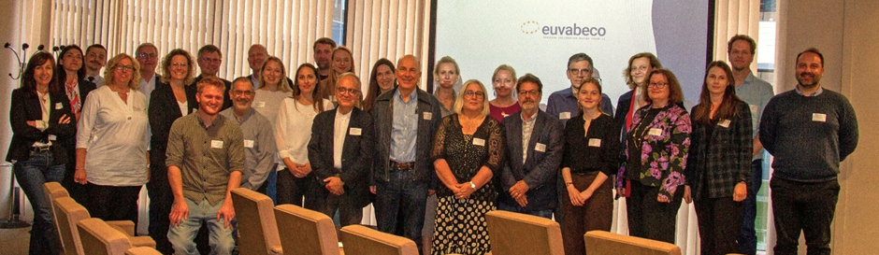
EUVABECO in Brussels – May 2024
Electronic Vaccine Card
SMART
WHO DDCC
Tools for Member States
Clinical Decision Support (CDS)
Screening for vaccination motivation
Electronic Patient Leaflet (ePIL)
Modeling and forecasting
Portable digital vaccination card (EVC)
https://euvabeco.eu/
Notes:
https://euvabeco.eu/

Slide 6
Roundtable Updates
Other countries or projects?

Slide 7
Widening the Scope
Nathan Bunker (AIRA)
François Kaag (Syadem)

Slide 8
Vision
Vaccines are the second most impactful public health intervention
Vaccine code set experts need someone they can call with questions about how vaccines should be coded

Slide 9
Vision
Network of vaccine code custodians and experts
Community of practice
Advocate for vaccine code system improvements
Unified voice
Support shared vaccine code resources
Unified Nomenclature for Vaccines (NUVA)
Mappings from vaccines codes to/from NUVA
Metrics and standards for vaccine code sets

Slide 10
Scope
In scope
Vaccine code set management
National and universal code sets
Technical/detail level
Codes that support lifetime of vaccinations given to patient at any time and in any country
Any vaccination received (emergency vaccinations turns rapidly into routine.)
Clinical trial vaccinations are an issue
May help, but not in scope
Support for medication supply, inventory, pharmacological vigilance, or other general medication functions.
Out of scope
Policy discussion
Which code sets to use
Software and systems

Slide 11
Importance of Vocabulary
Estimate that 60% of interoperability complexity is in the coding systems used
Estimate that 80% of the complexity of exchanging vaccination information is in the encoding
Regenstrief presentation:
The message structure: HL7, XML, FHIR, whatever, not critical
The codes are what really matters

Slide 12
NUVA Supports Universal Mapping
External codes (4846 in 18 codifications)
Vaccine code with used labels (995)
Valence (338)
Target disease (60)
Prevents
Contains
Exact Match
Data from March 19th, 2024
March 2024
IVCI workgroup

Slide 13
What is specific about vaccines ?
When compared to any drug
They have a very long-term effect
The protocols and the products vary across time and place
They are generally not substitutable
We need codes for administered vaccines
Lasting for decades (time robustness)
Convertible across countries (place robustness)
Precise enough to allow for consistent continuation of initiated vaccination schedules.
June 2024
IVCI workgroup

Slide 14
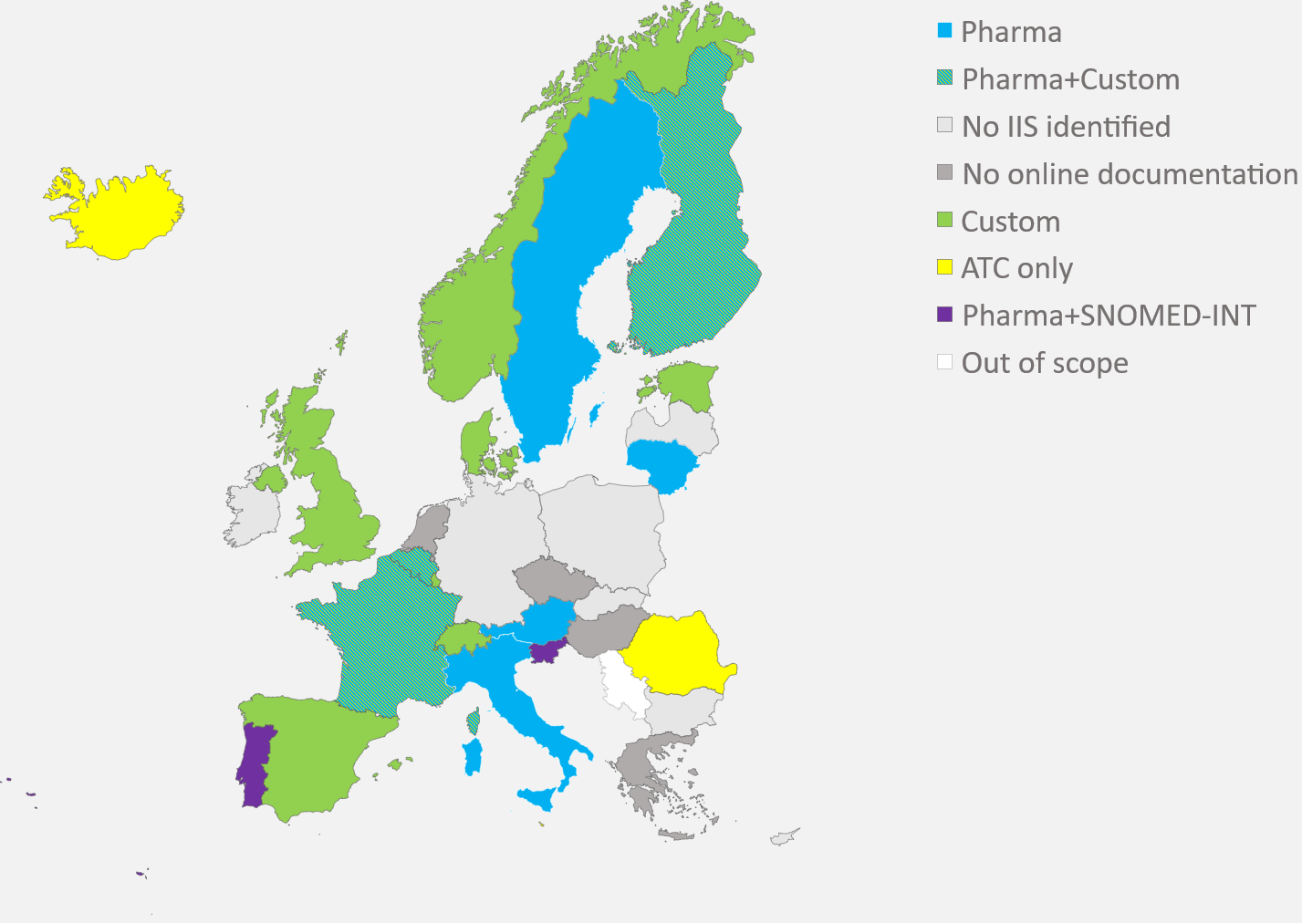
Vaccine code systems are fragmented
Custom or pharmaceutical codes (blue and green) are not compatible across countries.
EMA SPOR will unify pharmaceutical codes across the EU, but only for today’s products.
International mobility will not slow down.
June 2024
IVCI workgroup

Slide 15
Vaccine codes are either uncomplete or unprecise
Based upon existing alignments with NUVA.
Code System | Completeness | Precision
CVX | 90 | 19
ATC | 87 | 20
CIS (French pharma code) | 18 | 100
SNOMED-CT GPS | 81 | 15
Canadian Vaccine Catalog | 83 | 22
June 2024
IVCI workgroup

Slide 16
Codification efforts are not coordinated
Most countries :
Start with pharmaceutical code
Once in production, realize that it is not enough and complement with custom codes
Some anticipated and created fully dedicated code systems.
The most mature ones (i.e., Denmark, Canada) have built complete ontologies to bind vaccines codes, pharmaceutical codes, batch numbers, target diseases, etc. Yet they still address only domestic use.
June 2024
IVCI workgroup

Slide 17
The good news
There are not so many vaccines to identify (circa 1500 concepts)
This is not a competitive area
An informal network of stakeholders exists
The technical tools are available or uncomplicated
We can elaborate around a common asset, the NUVA terminology already discussed, that SYADEM intends to make a public good.
NUVA will be used for a portable vaccination card in an EU project across 12 countries.
June 2024
IVCI workgroup

Slide 18
What are we trying to do here ?
Share the need for a codification of administered vaccines, distinct from the general codification of drugs.
Organize collaboration among codification teams for:
A common understanding of the requirements for a code system
Common tools:
To evaluate and enhance their code systems
To ensure portability from one code system to another
Maintaining NUVA as a common dictionary of vaccines concepts aligned with all existing code systems
Upgrade this group to a legal entity, owning the common resources and gathering stakeholders from all countries.
June 2024
IVCI workgroup

Slide 19
What we do not intend to do
Replace existing code systems They are operational in their national contexts.
Address syntactic interoperability
Address purposes that are not specific to vaccines, such as pharmacovigilance, reimbursement, or logistics.
June 2024
IVCI workgroup

Slide 20
Who do we want in ?
Medical
WHO, CDC, ECDC, PAHO, DG Sante …
Global NITAGs Network
Technical
E-Health agencies
HL7, AIRA
SNOMED International
Industrial
Vaccine manufacturers
EHR suppliers
June 2024
IVCI workgroup

Slide 21
Milestone
We want to launch this extended IVCI with a conference to be held in May 2025 in Bordeaux (France).
In between, we have to:
Federate stakeholders
Build the legal structure and its operating rules
Transfer the ownership of NUVA and elaborate an open license
Enhance the tooling for collaboration and distribution

Slide 22
Any questions ?
François KAAG
+33 766 44 43 46
fkaag@syadem.fr
Louise BOURGES
+33 671 33 20 36
lbourges@mesvaccins.net
Jean-Louis KOECK
+33 647 88 63 33
jlkoeck@syadem.fr
March 2024
IVCI workgroup

Slide 23
Reactions
Any additional points we should focus on / communicate
Talking about the importance of the valence tree
The valences might be further differentiated into more categories
NUVA and CVX are different in that NUVA codes every single product, while CVX is staying generic
For US the product is better captured by NDC
We’ll be working on more metrics
NUVA defines “valence” as the smallest thing about a vaccination that is needed to evaluate immunization and recommend the next one
Represents antigens
Might be differences in criticality in valences

Slide 24
Next Steps
Nathan Bunker, AIRA

Slide 25
Future Discussions
Next Meeting
July 10

