Slide 1
International Vaccine Codes
January 2025

Slide 2
Agenda
Welcome & Introductions
Roundtable updates
Country and Project Outreach
Bordeaux May 2025
Next Steps
International Vaccine Codes (IVC) Initiative - 2024

Slide 3
Introductions
Name
Organization
Sheryl Taylor, US NIST
Alexandra Hayes, AIRA
François Kaag, Syadem
Joanna Hand, Ireland
Chrissy Miner, US CDC
Brittany Onye, US WA DOH
Barry Chesterman, NHS England
Bryant Karras, US WA DOH
Jeffrey Goggin, US RI DOH
Paloma Hawry, US CDC
Jussara Rotzsch, Brazil
Tania De Castilhos, US MI
Rebecca Sandveit, AIRA
Salvador Alvarado, UMC
Beatriz de Faria Leão, Brazil
Ed Ballestero, US KY
International Vaccine Codes (IVC) Initiative - 2024

Slide 4
Roundtable Updates
International Vaccine Codes (IVC) Initiative - 2024

Slide 5
Roundtable Updates
Brazil
Working with SNOMED-CT on GPS codes
International Vaccine Codes (IVC) Initiative - 2024
Notes:
https://build.fhir.org/ig/HL7/fhir-ips/StructureDefinition-Immunization-uv-ips.html

Slide 6
Country and Project Outreach
Nathan Bunker, AIRA

Slide 7
Country and Project Outreach
Country Contact List
Netherlands
England
Mexico
Belgium
Ireland
Brazil
Canada
United States
Organization Contact List
SNOMED
WHO
WHO UMC
PAHO
PATH

Slide 8
Outreach Plan for 2025
IVC
Partners & Funding
Training & Education
Codes & Tools
Outreach & Community

Slide 9
Partners & Funding
IVC
Partners & Funding
Training & Education
Codes & Tools
Outreach & Community
Key Activities
Plan Bordeaux May 2025

Slide 10
Training & Education
IVC
Partners & Funding
Training & Education
Codes & Tools
Outreach & Community
Key Activities
Develop training materials
Translate to Spanish & French

Slide 11
Codes & Tools
IVC
Partners & Funding
Training & Education
Codes & Tools
Outreach & Community
Key Activities
Maintain NUVA
Mapping of codesets
Metrics for codes sets
Tooling
NUVA Governance
Permanent Secretariat
Scientific Board
Technical Board
Assembly of users
IVC
NUVA

Slide 12
Outreach & Community
IVC
Partners & Funding
Training & Education
Codes & Tools
Outreach & Community
Key Activities
Find new participants
Orientation interviews
Help everyone find a place to contribute

Slide 13
Which are you most interested in?
Partner & Funding | Training & Education | Codes & Tools | Outreach & Community
Nicholas Llinas | Alexandra Hayes | François Kaag | Rebecca Sandveit
 |  | Nathan Bunker | Tania De Castilhos
 |  | Brittany Onye | Bryant Karras
 |  | Beatriz de Faria Leão
 |  | Jussara Rotzsch

Slide 14
Country and Project Contacts
Scope for Point of Contact needed, develop that and present back to the group
Country or Project | Community Liaison | Point of Contact
Canada
Mexico | Fernanda Valdez
Brazil | Tania De Castilhos | Blanda Mello
Netherlands
Ireland |  | Joanna Hand
Belgium
England |  | Barry Chesterman
United States |  | Paloma Hawry, Stuart Myerburg
France
EUVABECO participants…

Slide 15
Country and Project Contacts
Country or Project | Community Liaison | Point of Contact
Latin America en Español | Alejandro Arias
SNOMED
WHO
WHO UMC
PAHO

Slide 16
Point of Contact
First technical contact for questions about vaccine coding within their jurisdiction (region, country, province, state, etc.)
Key contact for decentralized, peer-to-peer network
Contact information only available for other peers in IVC
Responsibilities
Responding to technical questions, acting as first point-of-contact
Looping in relevant local experts, as needed
Collaborating with other POC, share strategies, learn from peers, improve coding practices globally
Attending IVC virtual calls and supporting IVC activities

Slide 17
International Liaison
Identified for a specific country or region
Ideal for those with cultural or professional ties
Builds relationships and coordinating activities
Responsibilities
Attending IVC meetings
Participating in decision making
Recruiting and maintain relationship with POC
Acting as a backup if POC is unavailable
Promoting collaboration and information-sharing

Slide 18
Cochair
Supports the planning and execution of IVC’s activities
Looking for at least four cochairs
François Kaag
Nathan Bunker
Nicholas Llinas
_______________

Slide 19
Bordeaux 2025
Nathan Bunker, AIRA & François Kaag, Syadem

Slide 20
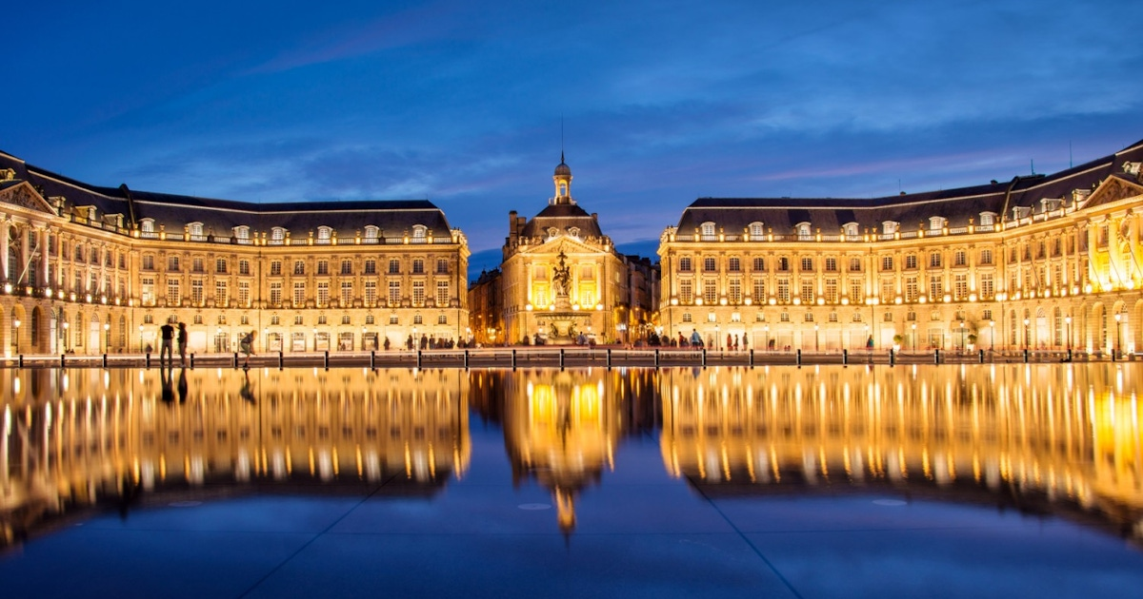
Bordeaux – May 9, 2025
In-person meeting scheduled
Set between a European meeting and HL7 WGM (in Madrid)
Will be discussing the future of IVC
Establish clear objectives and missing
Potential funding sources and partnerships
Plan future activities including standards development
Call for participation
Looking for local vaccine expert participation
Need your input to direct this work!

Slide 21
Agenda Planning

Slide 22
Who is attending?

Slide 23
Next Steps
Nathan Bunker, AIRA

Slide 24
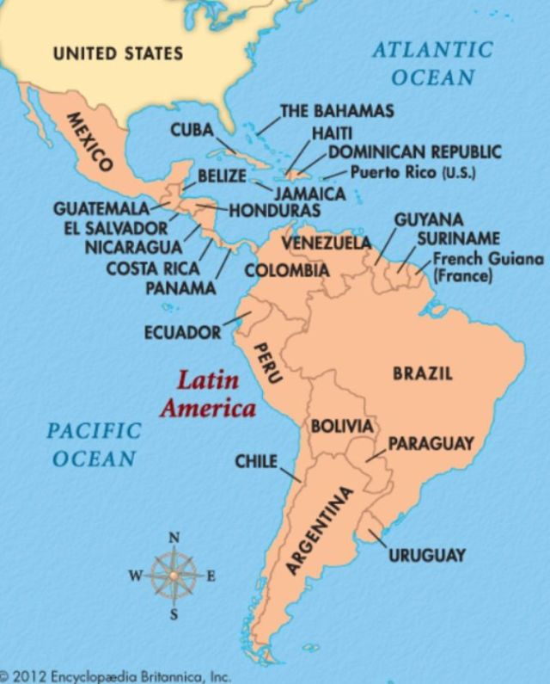
IVC en Español
Identified a facilitator – Alejandro Arias
High interest in the US community
Conducting interviews
Developing training content
Code systems in general
Relevant HL7 and FHIR standards
International code sets: SNOMED, ICD-11, ATC
Understanding and mapping code sets: NUVA
Country codes: CVX, CVC
When should we schedule? Feb 19, or Mar 12, or ?

Slide 25
IVC en Español
Identified a facilitator – Alejandra Arias
Content
Introductions – 5 mins
Map – put your pin on the map
Training
IVC introduction/scope what we are doing
Background on code systems (SNOMED, ICD-11, CVX)
UMC has content about drug codes
Discussion
How are things going?
What are the pain points?
How can IVC help?

Slide 26
How Can We Quantify the Impact?
Scope of the problem
How many countries face vaccine coding issues?
How often do we see incompatibilities?
Operation impact
What percentage of vaccine records fail to transfer?
How much time do staff spend transcribing?
What is the financial cost of these inefficiencies?
Patient impact
System readiness
For cross-border and cross-system transfers?
What volume of digital vaccination records?
Future challenges
What if we are not ready for the next pandemic?
Projected consequences if this remains unsolved?
SYADEM made a study on vaccination cards, observed countries that had setup IIS tried to code with their own pharmaceutical codes. Started using free text. Only 40% could be represented by France pharmaceutical, many were before the 90s Kentucky could possibly pull some figures regarding the quantity question by checking our UF vaccine codes. They are almost exclusively entered as historical from international vaccine cards. Our local health departments scan these cards and our IIS staff do their best to translate and document those vaccines as UF.
Notes:
Kentucky could possibly pull some figures regarding the quantity question by checking our UF vaccine codes. They are almost exclusively entered as historical from international vaccine cards. Our local health departments scan these cards and our IIS staff do their best to translate and document those vaccines as UF.

Slide 27
Next Meeting
Next Meeting
English: March 12, 2025
Español
8am ET / 4pm CET
In-Person
May 9, 2025 – Bordeaux

